Slide 1
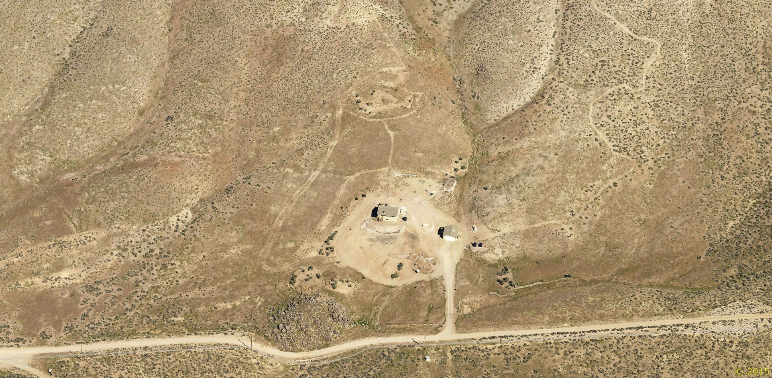
WSUP17-0006 (Rolling Thunder)
Washoe County Board of Adjustment
April 6, 2017

Slide 2
Background
To improve coverage and data speeds in the Warm Springs / Pyramid Hwy vicinity
Numerous dropped calls and spotty cellular reception well documented by residents
Facility would improve both cellular coverage and data speeds, to include E911 service
A “significant gap” (per 110.324.55) is not being claimed nor demonstrated

Slide 3
Background
Verizon explored 6 alternative locations throughout the northeastern portion of Warm Springs valley (aka the “search ring”)
These sites either did not satisfy service objectives or did not have willing leasers (owners)
Verizon has been trying to locate a facility in the area for over a year – but was delayed by the need for a Development Code Amendment

Slide 4
Background
DCA16-007 was approved to allow new cellular facilities in the GRA regulatory zone
Project is proposed on a 42-acre parcel in the General Rural Agricultural (GRA) regulatory zone
The site is surrounded by other +40-acre parcels
The Warm Springs Specific Plan is located southwest of the site, but over 2,000 feet away

Slide 5
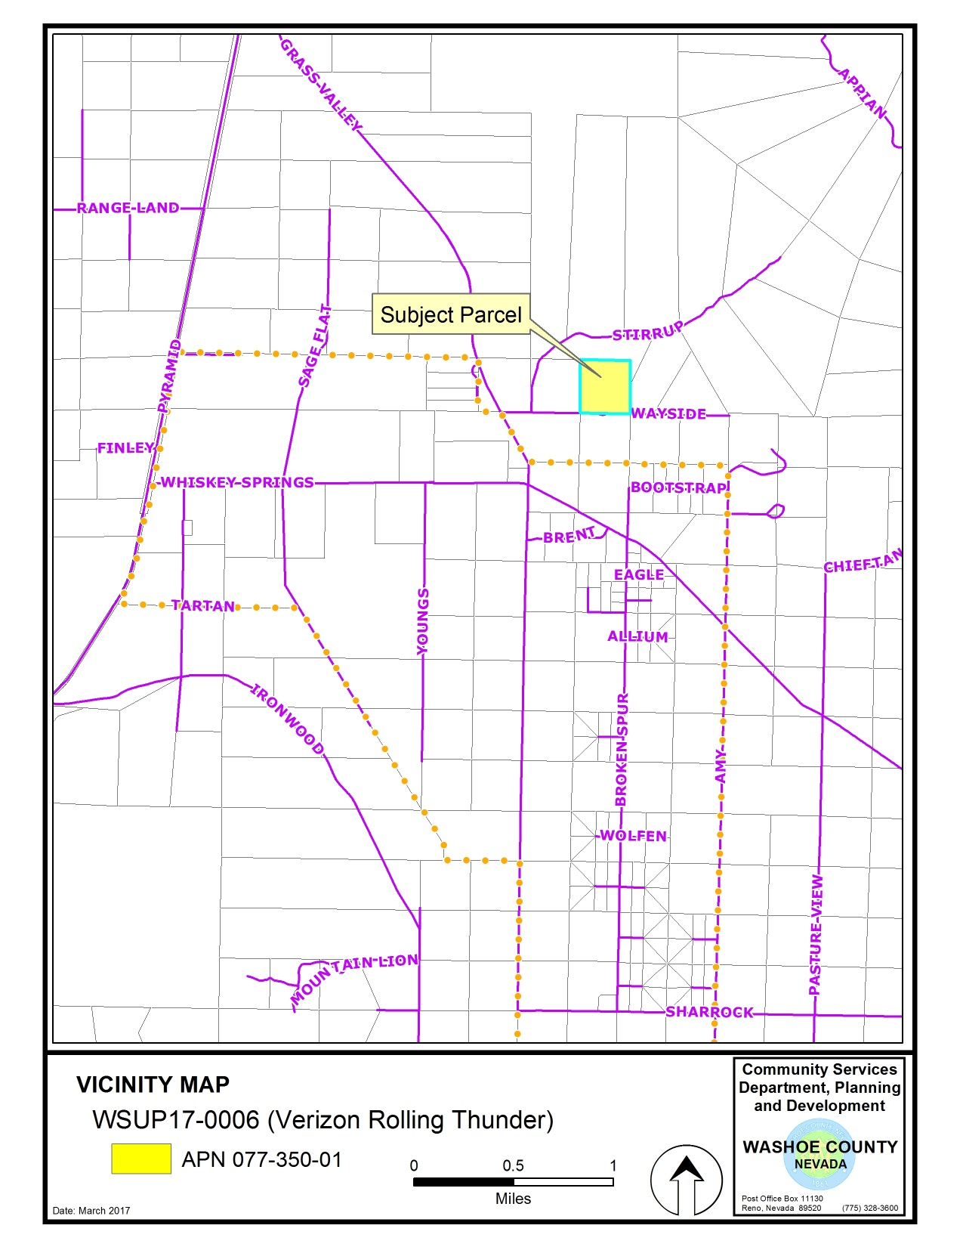

Slide 6
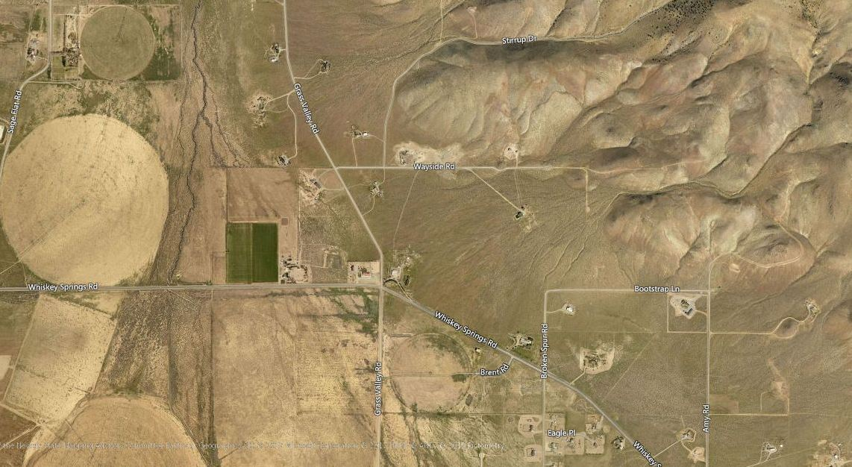
Vicinity Map - Aerial
Project Site

Slide 7
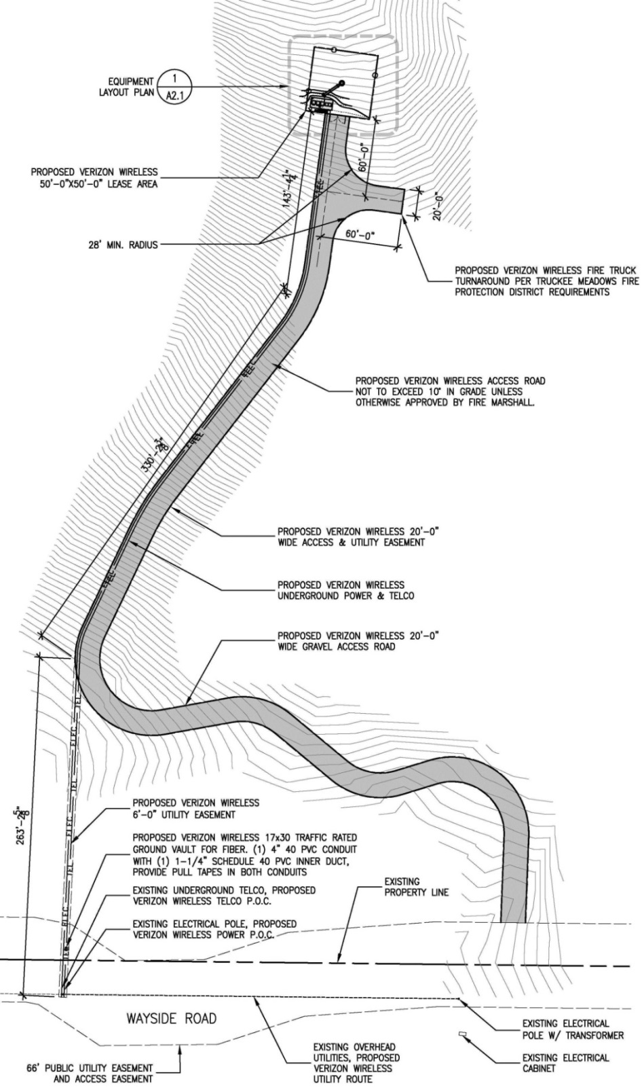
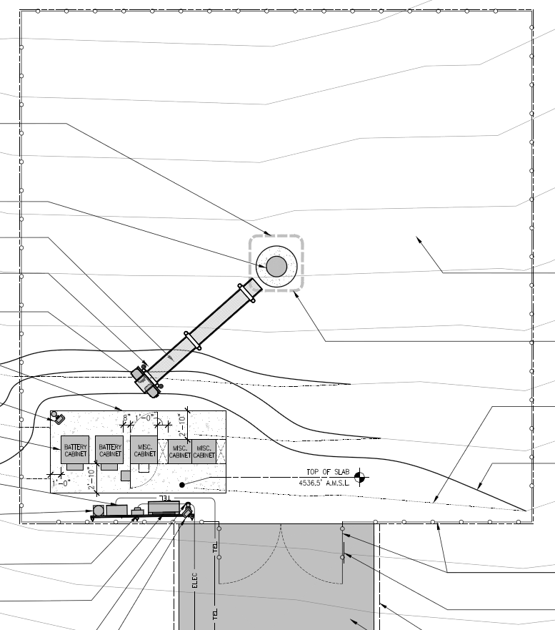
Site Plan

Slide 8
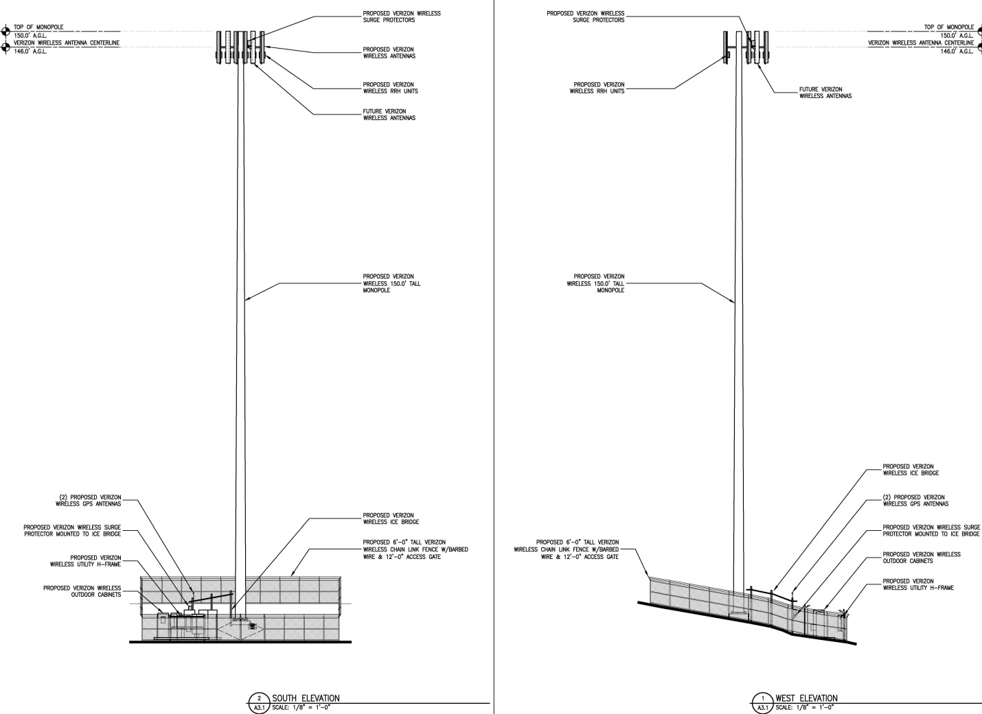
Elevations

Slide 9
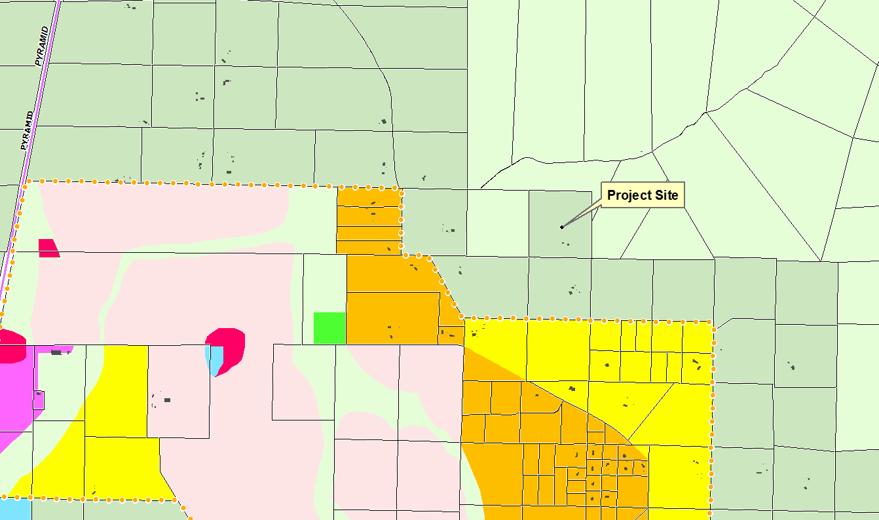
Adjacent Uses and Zoning

Slide 10
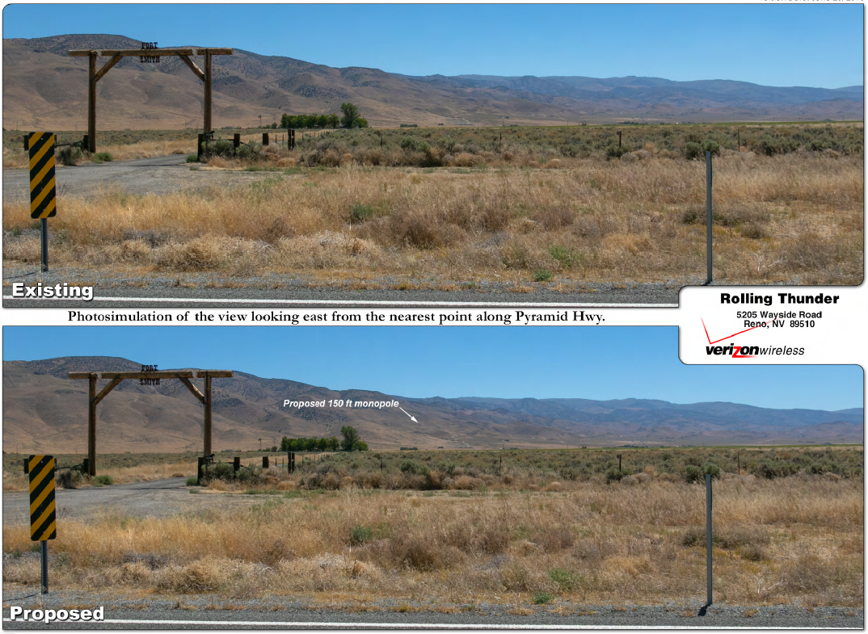
Photo Simulations
View From Pyramid Hwy

Slide 11
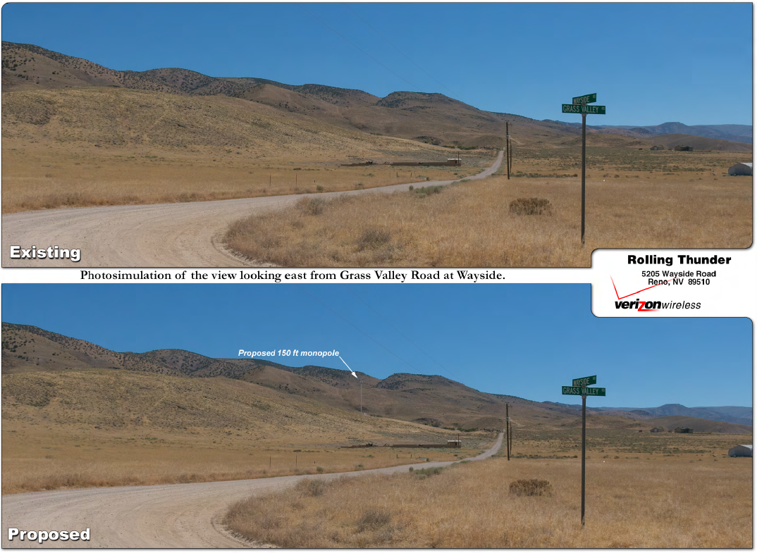
Photo Simulations
View From Grass Valley Rd

Slide 12
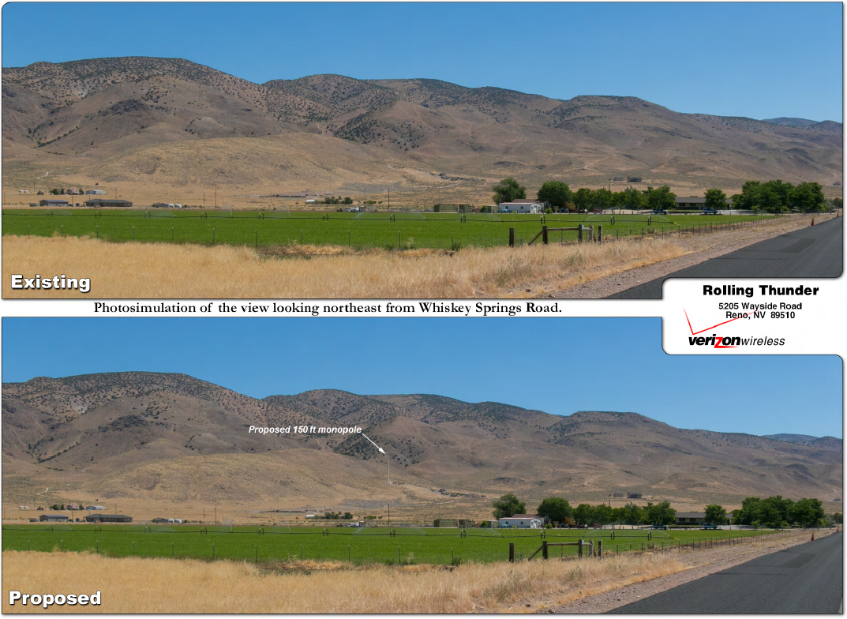
Photo Simulations
View From Whiskey Springs Rd

Slide 13
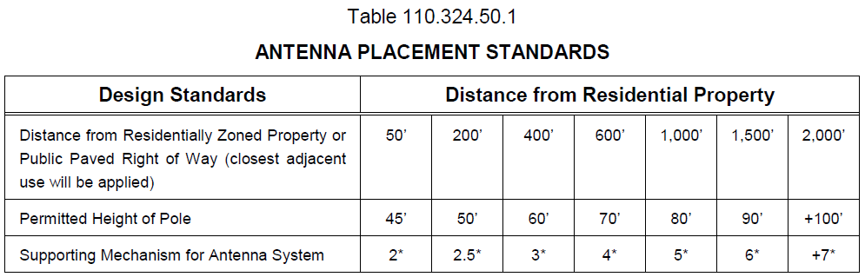
Analysis – Height and Visual Impact
The proposed height of the tower is 150 feet, which is technically allowed by code
The allowed height (in GRA) is governed by the placement standards of WCC Table 110.324.50.1

Slide 14
Analysis – Height and Visual Impact
As shown by the table, allowed height is based on the distance from residentially zoned property (there are no public paved ROWs’ closer)
The tower is proposed almost exactly 2,000 feet from the nearest residentially zoned property
Therefore, the allowable height is +100 feet
The code is silent on how high above 100 feet a tower can be (if beyond 2,000 feet)

Slide 15
Analysis – Height and Visual Impact
Note – A slim line pole is considered a “stealth” design, therefore by code an additional 25 percent in height is also allowed
This automatically brings the allowed height in this instance to 125 feet, regardless of the ambiguity in Table 110.324.50.1
Verizon claims the proposed 150 foot monopole has been designed at its minimum functional height to achieve service objectives for the area.

Slide 16
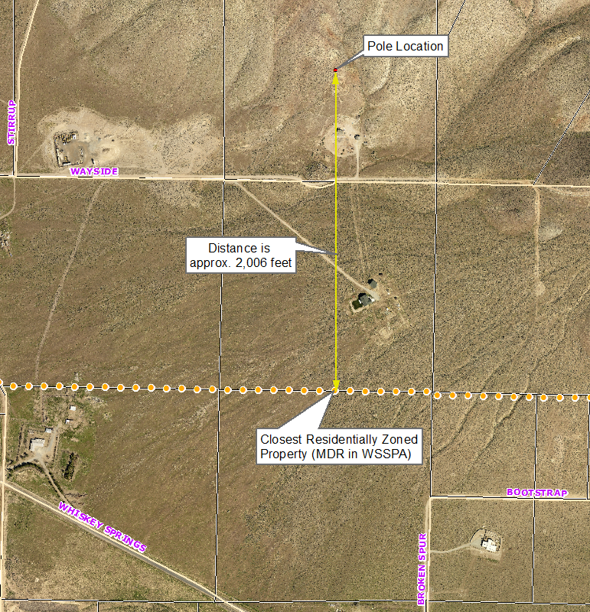
Analysis – Height and Visual Impact
Note: Proposed Condition of Approval requiring survey

Slide 17
Analysis – Height and Visual Impact
No significant ridgelines are impacted – the tower is in the foothills with the Pah Rah range in the backdrop
Is not within 1,000 feet of any public trail
The project site is already partially disturbed
There are no other poles or cellular facilities in the vicinity
Reflective materials will not be allowed and the pole will be painted a neutral color

Slide 18
Analysis – Zoning and Setbacks
The subject parcel is zoned General Rural Agricultural (GRA), which allows the use by SUP
The facility has been designed to accommodate future collocation of additional carriers
The proposed location meets the required structure setbacks (i.e. 30’ F/R, 50’ side)
The facility is approximately 600 feet from the nearest property line

Slide 19
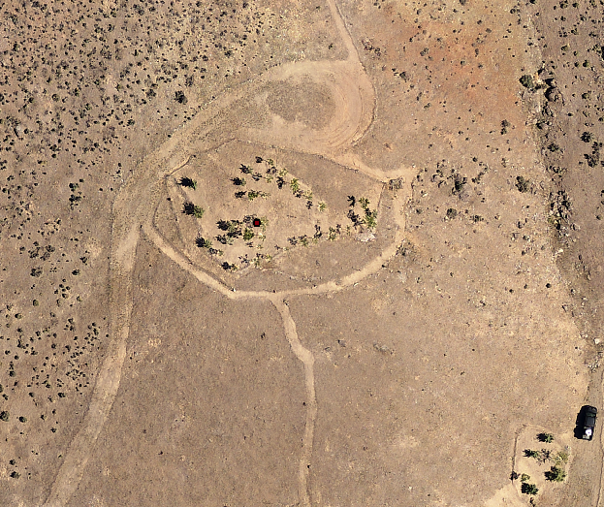
Analysis – Access and Grading
The pad for the proposed lease area will be located in an area that is already partially disturbed/graded:

Slide 20
Analysis – Access and Grading
Access to the pad will be off of Wayside Road along an existing partially improved dirt road
The road alignment will be improved to a 20 foot wide gravel road that meets fire and engineering standards (with easements)
Improvements will include an emergency access fire truck turnaround (not exceed 10% in grade)
Since the facility will be unmanned, no parking improvements are proposed (but space avail.)

Slide 21
Analysis – Access and Grading
Grading details, for either the road or the lease pad, were not provided with the application
Staff has requested grading plans but did not receive them in time for this hearing (the applicant is working on them)
Grading will therefore have to be reviewed as part of the building permit application and may trigger a separate SUP if thresholds are exceeded
Condition of Approval included

Slide 22
Analysis – Utilities and Landscaping
Utility lines to the facility will be placed underground and within easements
Lighting will be minimal – one down shielded motion sensor light
Landscaping is not proposed due to the remote, unimproved nature of the area and general lack of vegetation and irrigation
By code, the BOA has the authority to vary standards and may waive landscaping requirements (no Directors Modification sub.)

Slide 23
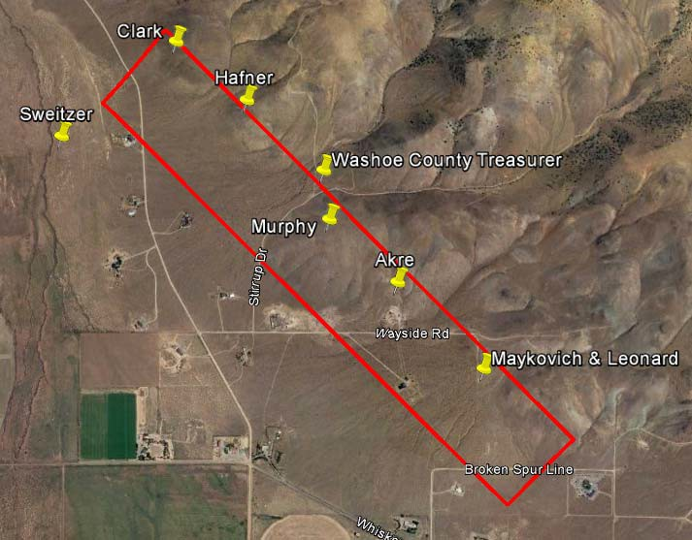
Alternative Site Analysis
See detailed explanation on Page 18 of the Staff Report

Slide 24
Reviewing Agencies
The following reviewing agencies requested conditions of approval:
  Planning and Development
  Land Development, Engineering and Capitol Project Division
  Palomino Valley General Improvement District
See Exhibit A of the staff report for the recommended conditions of approval

Slide 25
Citizen Advisory Board/Public Comment
The Warm Springs/Rural Citizen Advisory Board did not meet during the review period
The application was distributed to CAB members for their review and comment
Staff has not received any comments from CAB members or the general public

Slide 26
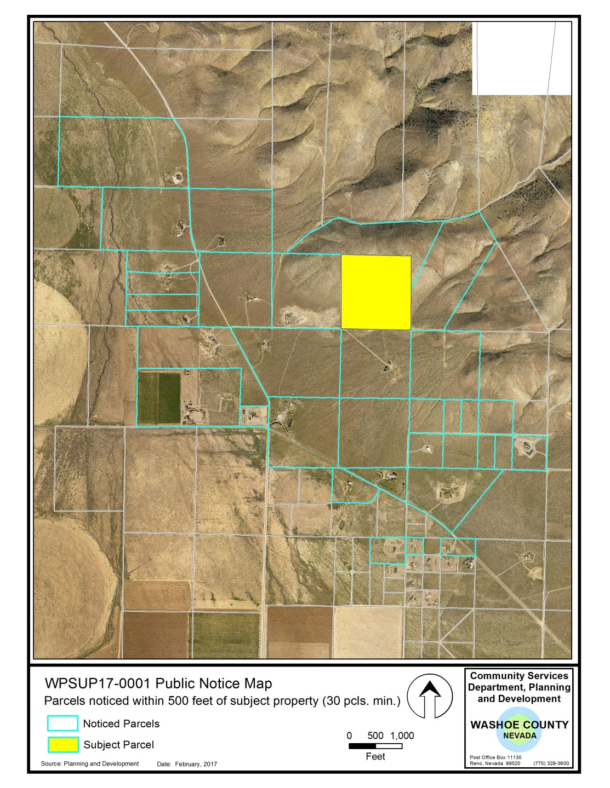
Mailing Notice Map
A minimum of 30 parcels were noticed

Slide 27
Required Findings
WCC Section 110.810.30, Article 810 Special Use Permits (Consistency with Master Plan, Adequate Improvements, Site Suitability, Issuance Not Detrimental, Effect on Military Installation)
WCC Section 110.324.75, Article 324 Communication Facilities (Meets Standards, Public Input, Impacts)
Consistency with the Warm Springs Area Plan

Slide 28
Required Findings
Staff analysis is provided in the staff report starting on page 21
Staff is able to make all of the required findings

Slide 29
Staff Recommendation
After a thorough analysis and review, Special Use Permit Case Number WSUP17-0006 for Verizon Wireless (Rolling Thunder) is being recommended for approval with conditions.

Slide 30
Possible Motion
I move that, after considering the information contained within the staff report and the information received during the public hearing, the Washoe County Board of Adjustment approve, with the conditions included at Exhibit A to the staff report for this item, Special Use Permit Case Number WSUP17-0006 for Verizon Wireless (Rolling Thunder), being able to make the findings required by Washoe County Code Section 110.810.30, Section 110.324.75, and consistency with the Warm Springs Area Plan.

Slide 31
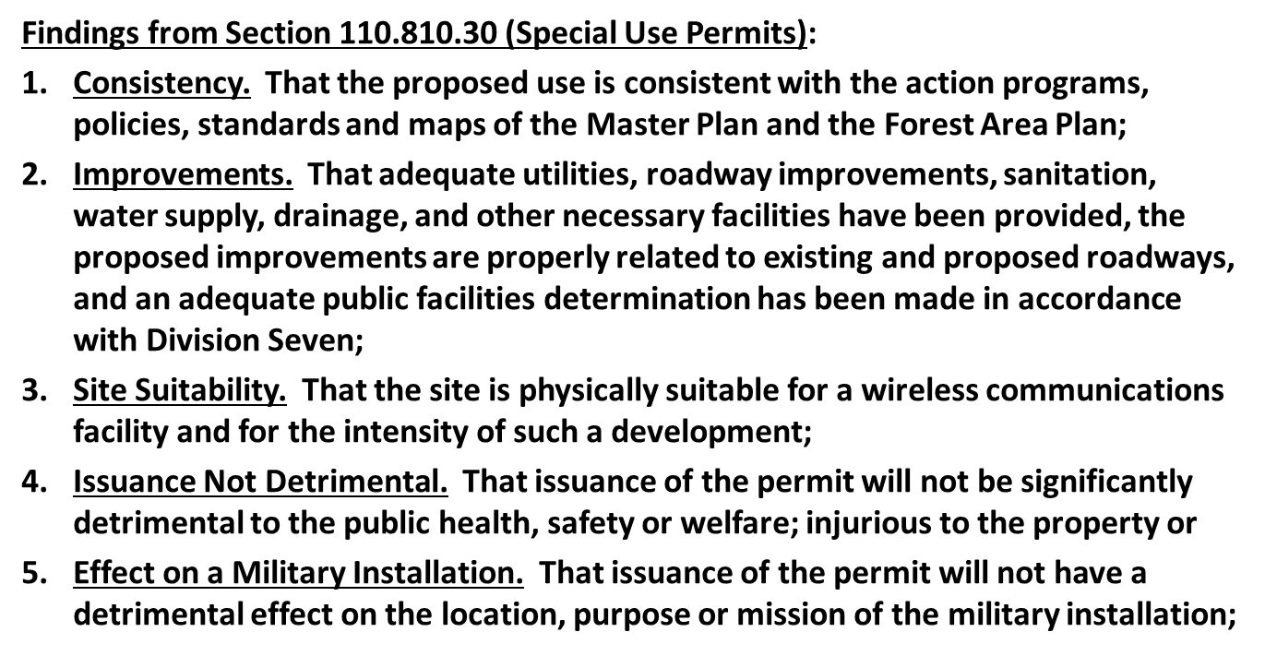
Motion Findings

Slide 32
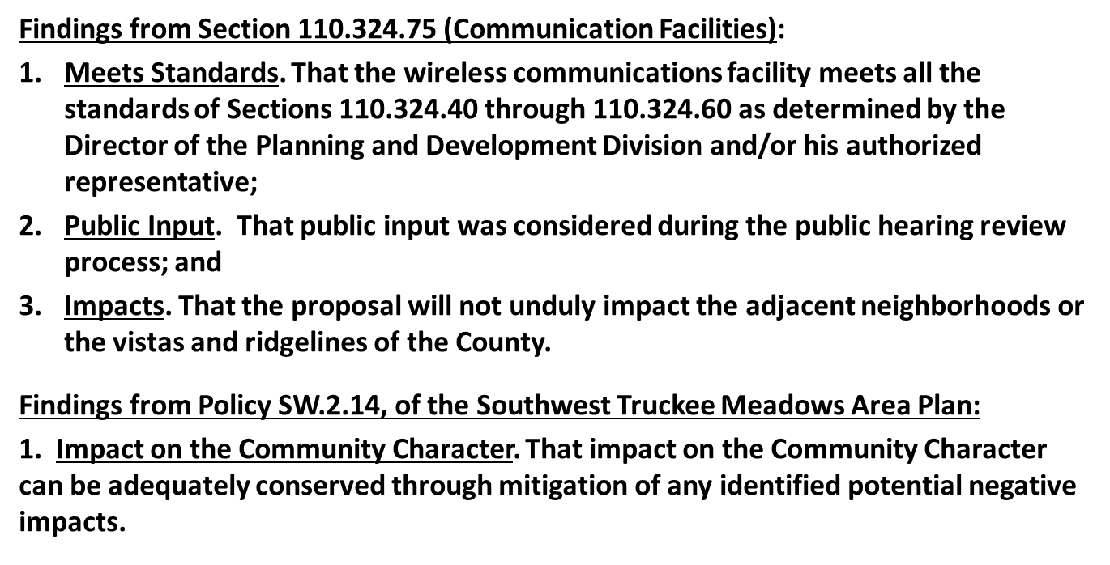
Motion Findings

Slide 33
Appeal Process
Board of Adjustment action will be effective 10 calendar days after the written decision is filed with the Secretary to the Board of Adjustment and mailed to the applicant, unless the action is appealed to the Washoe County Board of County Commissioners, in which case the outcome of the appeal shall be determined by the Washoe County Board of County Commissioners. Any appeal must be filed in writing with the Planning and Development Division within 10 calendar days after the written decision is signed by and filed with the Secretary to the Board of Adjustment, and mailed to the applicant.

Slide 34
QUESTIONS?

